Slide 1
Cincyville Tech Circle and Data & Analytics Meetup
Shawn Wallace
October 2022

Slide 2
Agility’s Affect on Solutions

Slide 3
Business
Application Development
Analytics

Slide 4
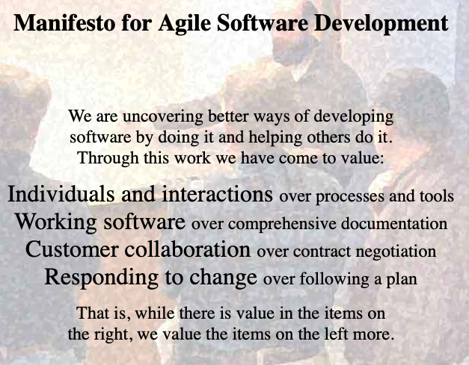
Business
Application Development
Analytics

Slide 5
Business
Application Development
Analytics
Tension

Slide 6
Conflict led to innovations and capabilities
Notes:
Cloud
Automation
Test Automation
Continuous Integration
Continuous Delivery
Streaming Analytics
Business Agility

Slide 7
Business Consulting Services
MSD
Salesforce
Modern Workplace
Data & Analytics
Notes:
Let’s change to Centric terminlogoy and align to our Service Offerings

Slide 8
MSD
Salesforce
Modern Workplace
Business Consulting Services
Data & Analytics

Slide 9
Before 2020
MSD
Salesforce
Modern Workplace
Business Consulting Services
Data & Analytics

Slide 10
2021
MSD
Salesforce
Modern Workplace
Business Consulting Services
Data & Analytics

Slide 11
We need to start approaching our clients with cross-disciplined teams that collaborate on a combined solution.
Notes:
Break down the silos.

Slide 12
Enterprise/Integration Architecture

Slide 13

Moving data between subsystems to implement larger business processes.
Integration Architecture
13
Notes:
Potential Stat: “20 Billion connected devices by 2020”?

Slide 14
Monolith
Orders
Warehouse
Accounting
Customers
Shipping
Logging
Tightly Coupled

Slide 15
Services-Oriented Architecture
Orders
Warehouse
Accounting
Customers
Logging
Shipping
Still Tightly Coupled
Notes:
AND WE ORCHESTRATE PROCESSES
Our architectural patterns have been to split things up. The problem is how to we connect them properly.

Slide 16
Services-Oriented Architecture
Orders
Warehouse
Accounting
Enterprise Service Bus
Customers
Logging
Shipping
STILL Tightly Coupled
Notes:
AND WE ORCHESTRATE PROCESSES

Slide 18
Style Considerations, Usage Context and best practices
In General, the following considerations should be considered when designing integrations.
Data-centric Integrations: This approach generally involves moving data across repositories and when performing batch or extract operations that require large data sets and high accuracy. There are existing cases where an API is directly called through the consumption layer of the Data Warehouse and designers should evaluate benefits against cost when considering a different approach vs. leaving existing approaches in place.
App-centric Integrations: This approach will typically involve calling of an API or service that directly connects one system to another. While this is not loosely coupled, it is sometimes a straightforward and economical approach. When evaluating or designing new integrations, evaluate the cost-benefit of this approach against the other styles. Note that an API or service can also be leveraged in both event-centric styles and even data-centric styles. It is app-centric when the API is tightly-coupled with a system.
Event-centric: This approach involves the production and consumption of events into an event distribution platform. Applications Integrate with the platform by generating/producing events when certain transaction lifecycle stages occur and consuming events from other applications generated similarly. The event distribution platform only manages the acceptance and delivery of events to connected applications and should provide no business processing or data transformation. This approach scales well, allows applications to be loosely coupled, but can require more complex infrastructure. This is the tradeoff for the simple, single-threaded services that can be created. This approach also becomes more common as organizations adopt micro-services.

Slide 19

Contact Us
Shawn Wallace
Principal Architect, Tech SL
614 - 270 – 1600
shawn.wallace@centricconsulting.com
www.centricconsulting.com
19
Notes:
- The next steps section will be your wrap up and thank you slides. We are going to add a slide for you to be able to list what’s next before we move to the contact us slide, so that will be available when we distribute the deck to all of Centric.

Slide 20
A Modern Architecture

Slide 21
Guiding Principles
All design patterns and practices are driven by a set of guiding principles
Business Capability
Agility, Speed to market/value, Governable, Intelligence, Supports Processes
Technical
Loosely-coupled, Composability, Design, Simplicity, Scalability, Robust (async and sync), Telemetry/Instrumentation, Operational Simplicity, Testable, Easy to upgrade/change
Team
Leverages team strengths, Leverages team skills, Incremental rollout, Non-invasive, Non-technical admin

Slide 22
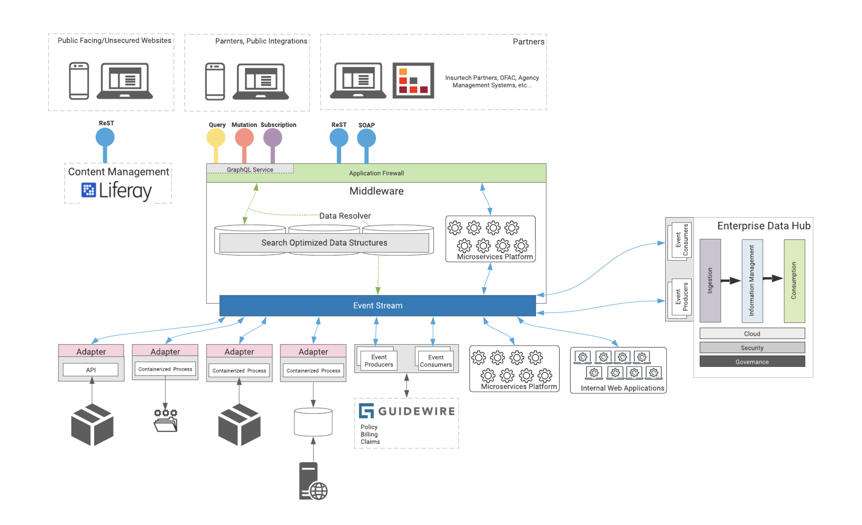

Slide 23
Event-driven Architecture Features
Loosely Coupled
Easy Integration
Supports many scaling models
“Data in Motion”
Favor asynchronous interactions

Slide 24
Template Overview
How to Use this Deck
This deck serves as both a visual guide and a tool to help you streamline and simplify the process of creating presentations.
TIPS:
Avoid sizing copy that’s smaller than 11 pt or larger than 28 pt
Less is more: The clean and spacious layout improves readability and engagement—try to consolidate messaging and keep bullets punchy.
Spread out a busy slide into two separate slides
Use varying type sizes and weights (regular, italic, bold) to create hierarchy within content and help viewers eye read in intended order
Integrating elements and slides from this template will help maintain the integrity of Centric’s brand.
Most slides are modular and can be used by editing the variable content while ensuring the formatting is consistent across all Centric decks
Section Divider slides can be leveraged by replacing the image and changing copy
Important: Please export PowerPoint decks as PDFs when sharing externally
If you are having trouble with anything in this template, you are looking for additional brand elements or you are unsure if your communication best represents the Centric brand, please contact Centric’s design team at lisette.albert@centricconsulting.com
24

Slide 25

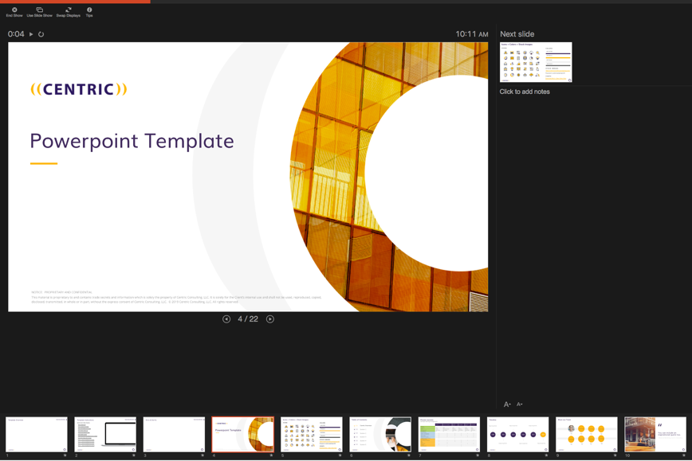
Template Instructions
How to Use this Deck
Quick Links to Video Tutorials (open slide in presentation mode to click links):
How to Install the Centric PowerPoint Template
How to Print Widescreen Format
Using Centric Branded Colors
How to Switch Layouts
How to Access and Use Different Icons or Images
How to Fill a Shape with an Image
How to Resize an Image without Screwing it up
How to Compress your File Size
How to Access our Marketing Materials

Slide 26






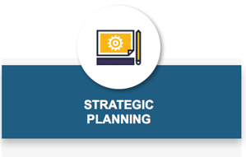
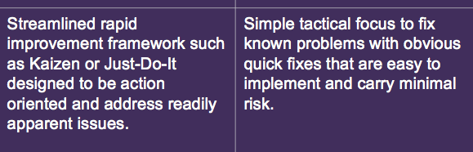
Do’s & Don’ts
How to Use this Deck
Most copy should be the ‘dark grey’ color located in the theme.
Callout words can be treated in either purple or yellow as an accent.
Copy may not be an off-brand color or a screen of purple or yellow.
YES
YES
NO
YES
NO
Use branded icons (Three treatment options: In white circle, alone, or reversed out over yellow circle)
Never use off-brand icons
YES
YES
NO
Images should be bright and include yellow.
Non-people images can have abstract meanings
Never use duotone images.
YES
NO
Reverse copy out of solid color for headers and subheaders
Avoid using reversed copy for paragraphs or body copy

Slide 27



Co-branding Guidelines
How to Use this Deck
Follow these guidelines when using a partner or client logo in a lockup with the Centric logo.
YES
NO
&
Use full-color logos on a white background whenever possible
Ensure both logos are roughly equal in visual weight
Separate the logos by a space equal to the Centric quote marks with a black, ½ pt vertical rule extending a single quote mark above and below the largest ascending and descending elements
Optically align logos to best balance
Don’t alter the divider or add any extraneous design elements
Don’t combine full-color and B&W versions of the logo together
Don’t use low quality or distorted logos

Slide 28
Icons + Colors + Stock Images
ICONS
COLORS
#2C1A5D
#FCB516
#E7E6E6
#262626
STOCK IMAGES & ICONS
https://centricconsulting.smugmug.com/
Password: centricmarketing123!

Slide 29

Table of contents
0X
Centric Overview
Section 1
Section 2
Section 3
Section 4
Section 5
XX
XX
XX
XX
XX
Notes:
Designed Table of Contents if you want to incorporate page numbers and animation.

Slide 30
Simple table of contents
Title 1
Title 2
Title 3
Notes:
Simple table of contents if you’re looking to create a table of contents quickly.

Slide 31
Proven success
Example teaming arrangements
 | Fidelity | Luxottica / EyeMed | Cardinal Health | AssuraMed | Ascension Health | Nationwide
Background
Company Size | $10B+ | $8.5B | $101B | $1B | $14.3B | $22.4B
Industry | Financial | Vision Care / Insurance | Health Care | Health Care | Health Care | Insurance
Relationship Duration | 2003 to Present | 2007 to Present | 2004 to Present | 2012 to Present | 2009 to Present | 2000 to Present
# of Engagements | 50+ | 35+ | 33+ | 6+ | 10+ | 30+
Business Consulting
Program / Project Management | X | X | X | X | X | X
Business Process Improvement | X | X | X | X |  | X
Business Analysis | X | X | X | X | X | X
Organizational Change Mgmt. | X | X |  |  | X | X
Strategic Planning / Bus Architecture | X |  | X
Technology Consulting
Custom Application Development | X | X | X | X | X | X
BPM | X |  | X | X
Mobile |  | X |  | X
Data & Analytics | X | X |  |  | X | X
IT Strategy | X |  |  | X
Portal / E-Commerce |  | X |  | X
Notes:
Include slide when outlining engagement types, you can use it in conjunction with slide 20

Slide 32
Timeline
Copy can go here
Copy can go here
Copy can go here
1999
2001
2010
2016
2017
2019
Copy can go here
Copy can go here
Copy can go here

Slide 33

Meet our team
Fill with image
Fill with image
Fill with image
Name
Name
Name
Name
Title
Title
Title
Title
Fill with image
Fill with image
Fill with image
Fill with image
Name
Name
Name
Name
Title
Title
Title
Title
Notes:
If the headshot image gets distorted when you fill the yellow circle background, go to Picture Format → click the down carrot next to Crop → Click Fit → resize image to fit the circle while holding Shift.

Slide 34

You can include an inspirational quote too.
- National Marketing, Centric Consulting
Notes:
Quote

Slide 35
Agenda Slide
Introduction
Lauren - 1:00 – 1:20
Topic 2
Jacob – 1:20 – 2:00
Topic 3
Sarah – 2:00 – 3:00
35

Slide 36
Stats side
79%
77%
64%
32%
Cool statistic goes here
Cool statistic goes here
Cool statistic goes here
Cool statistic goes here

Slide 37


Case Study Template A — Long Version // If client is not confidential, use their logo (ensuring sufficient white space around it).
Centric Delivers
Deployed 30+ client solutions using new process, meeting the annual target Centric worked with the Broker Leadership to:
Establish and execute the standard deployment process
Provide program management in overseeing timelines, resource assignments, and budgets
Establish transparency between software vendor, project team, and broker leadership
Ensure risks were identified, communicated, and mitigated appropriately
Create a project team structure for successful delivery
Set routine and standards with software vendor around testing
Deliver continuous improvement to the deployment approach
Employee Benefits Product Implementation
Centric leveled experience in program management to develop a strong implementation strategy for employee benefits program
The Business Need
The client’s brokerage leadership wanted an employee benefits program to offer as a service to existing group insurance clients. The project was in progress but struggling to get to completion. The broker desired project governance and true leadership to deliver the employee benefits package to multiple clients. They also needed to ensure Affordable Care Act reporting was completed in an accurate and timely fashion.
Benefits
Useful and exciting product to offer to existing clients
Tailored employee benefits enrollment and management system designed to provide employee self-service and eliminate paper processing
Incentive to keep clients at the broker (versus them moving to another firm)
Established internal confidence for organization’s ability to deliver
Improved communication and collaboration between PMO, IT, Business, and clients

Slide 38
Case Study Template B — Long Version // If client is confidential, type 2-4 word reference to company in yellow bar. (ie. “Fortune 100 Technology Company”)
Employee Benefits Product Implementation
Centric Delivers
Deployed 30+ client solutions using new process, meeting the annual target Centric worked with the Broker Leadership to:
Establish and execute the standard deployment process
Provide program management in overseeing timelines, resource assignments, and budgets
Establish transparency between software vendor, project team, and broker leadership
Ensure risks were identified, communicated, and mitigated appropriately
Create a project team structure for successful delivery
Set routine and standards with software vendor around testing
Deliver continuous improvement to the deployment approach
Centric leveled experience in program management to develop a strong implementation strategy for employee benefits program
Confidential Company Name Here
The Business Need
The client’s brokerage leadership wanted an employee benefits program to offer as a service to existing group insurance clients. The project was in progress but struggling to get to completion. The broker desired project governance and true leadership to deliver the employee benefits package to multiple clients. They also needed to ensure Affordable Care Act reporting was completed in an accurate and timely fashion.
Benefits
Useful and exciting product to offer to existing clients
Tailored employee benefits enrollment and management system designed to provide employee self-service and eliminate paper processing
Incentive to keep clients at the broker (versus them moving to another firm)
Established internal confidence for organization’s ability to deliver
Improved communication and collaboration between PMO, IT, Business, and clients

Slide 39

Change background image.
Company name Case Study Title
Fill with screenshot
Fill with screenshot
1-2 sentence description

Slide 40

Case Study Title
FORTUNE 500
Healthcare Services logo
1- 2 sentence description of case study
Results
Tangible results 1
Tangible results 2
Tangible results 3

Slide 41
Header statement
Key message
Option 1
Bus estem fugiassin res es exceatiatin pe vit, con nonecepro occumqui doluptatia volupit, qui to eum quidenit, exceptatem doluptate molore accus quisimolo ipset conet, solecti onsenis.
Option 2
Bus estem fugiassin res es exceatiatin pe vit, con nonecepro occumqui doluptatia volupit, qui to eum quidenit, exceptatem doluptate molore accus quisimolo ipset conet, solecti onsenis.
Option 3
Bus estem fugiassin res es exceatiatin pe vit, con nonecepro occumqui doluptatia volupit, qui to eum quidenit, exceptatem doluptate molore accus quisimolo ipset conet, solecti onsenis.
Option 4
Bus estem fugiassin res es exceatiatin pe vit, con nonecepro occumqui doluptatia volupit, qui to eum quidenit, exceptatem doluptate molore accus quisimolo ipset conet, solecti onsenis.

Slide 43

3 Key Takeaways
1
Takeaway 1
2
Takeaway 2
3
Takeaway 3
Takeaway 4
BONUS
43

Slide 44


Value slide
Decreased
User frustration
Development time
Hardware & storage costs
Business Continuity & Disaster Recovery costs
Enterprise computing costs
Monitoring & backup costs
Training & support costs
Maintenance costs
Software licensing costs
Speed and agility
Pace of innovation
Ability to match spend to business need
Accessibility
Scalability
Availability
Flexibility
Security
Enforceability
Portability
Reliability
Increased
44
Notes:
Checkpoint to crowd – who is doing what?

Slide 45

4 options or a grid
YOUR TITLE
YOUR TITLE
Far far away, behind the word mountains, far from the countries Vokalia and Consonantia, there live the blind texts.
Far far away, behind the word mountains, far from the countries Vokalia and Consonantia, there live the blind texts.
Far far away, behind the word montains, far from the countries Vokalia and Consonantia, there live the blind texts.
YOUR TITLE
YOUR TITLE
Far far away, behind the word mountains, far from the countries Vokalia and Consonantia, there live the blind texts.
Far far away, behind the word mountains, far from the countries Vokalia and Consonantia, there live the blind texts.
45

Slide 46
Title
Bullet
Bullet
Bullet
46

Slide 47
Example statement: IoT Market will grow to almost $500B by 2020; connecting nearly 30 Billion devices.
Forbes 2017
47
Notes:
Potential Stat: “20 Billion connected devices by 2020”?

Slide 48

Definition of service
Short paragraph about service
20%
STAT COPY CAN GO HERE BY THE YEAR
50%
INCREASE IN STAT COPY INSERTED HERE
2020
OF ENTERPRISES WILL RUN ON CONTAINERIZED APPS
48

Slide 49

Title for Obstacles / Journey Mapping
Hidden
Costs
IT
Org Change
Partners
Sales
Regulatory
& Security
Over-hyped
Expectations
Industry
Disruptors
49
Notes:
True innovation has seen missteps from organizations because it is complex and requires moving the organization into new places and avoiding obstacles. Want to review three stories on how we have been able to do this

Slide 50
First Name Last Name
TITLE
Email@emailgoeshere.com
Short bio goes here.
Fill this shape with team member image
CLIENT EXPERIENCE:
EXPERT IN:
Bullet 1
Bullet 2
Bullet 3
Bullet 1
Bullet 2
Bullet 3
22

Slide 51

4 Step Approach
Key message
STEP 1
Bullet 1
Bullet 2
Bullet 3
STEP 3
Bullet 1
Bullet 2
Bullet 3
Bullet 1
Bullet 2
Bullet 3
Bullet 1
Bullet 2
Bullet 3
STEP 2
STEP 4
51

Slide 52
Contact Us
First-name Last-name
Title Placeholder
123 - 456 – 7890
email@centricconsulting.com
www.centricconsulting.com
52
Notes:
- The next steps section will be your wrap up and thank you slides. We are going to add a slide for you to be able to list what’s next before we move to the contact us slide, so that will be available when we distribute the deck to all of Centric.

